Slide 1
Diversity and Social Justice

Slide 2
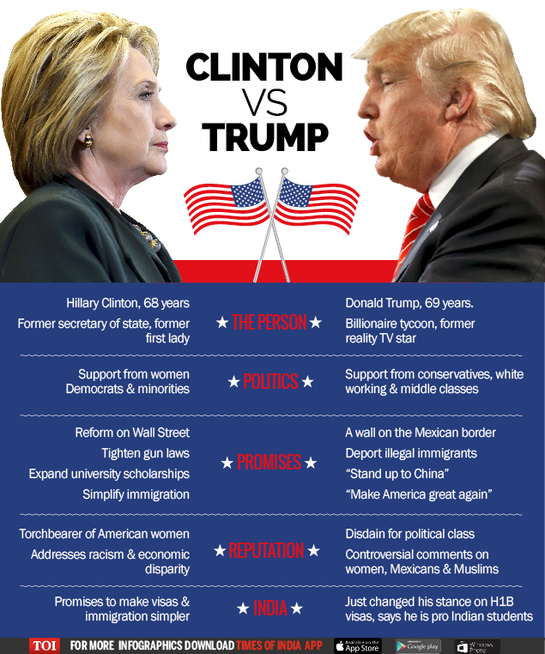
This is going to be a challenging Semester

Slide 3
We have a responsibility to educate and welcome all students
This can be a challenge because not every student we work with is going to agree with us on a philosophical level.
“Are you going to vote for the good guy or the socialist?”
Different people choose to support the candidate they will vote for in November for different reasons:
  They truly believe that either Clinton or Trump will a good president
  They truly believe that either Clinton or Trump will be a terrible president
  They supported one candidate in their party’s primary and that candidate did not win, so they will vote for the party’s candidate
  They supported one candidate in their party’s primary and that candidate did not win, so they will vote against the candidate who defeated him/her
  They cannot support either Trump or Clinton, and will vote for a third party candidate
  They cannot support either Trump or Clinton and will not vote
New York, New Jersey, and Connecticut are not swing states, meaning that the electoral votes will probably go to Hillary Clinton. Many Republican students may feel their votes don’t count and may feel disenfranchised.
Some students cannot vote for one reason or another, but still may have strong opinions regarding their preference.

Slide 4
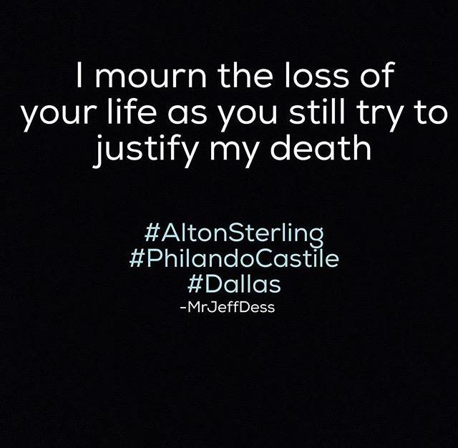
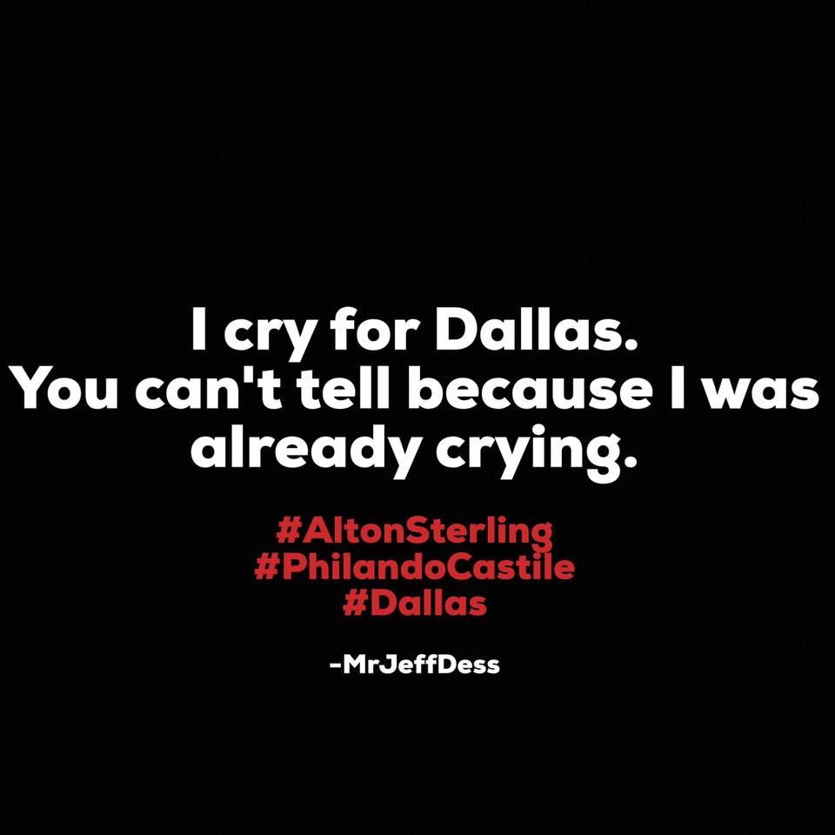
This is going to be a challenging Semester

Slide 5
We have a responsibility to challenge discrimination
Some students on campus are blatantly discriminatory
https://youtu.be/zq7sipKfxoo?t=2m45s
Some students do not necessarily view their actions or beliefs as discriminatory
  While All lives do matter, the hashtag #Alllivesmatter is used to attempt to ignore the real issues surrounding racial inequality in America.
  However, not every student you work with is going to see it that way.
  Some students come from traditions in which LGBT Marriage is not permitted. They have a right to practice their religion in their way and be supported.
  LGBT marriage is legal in the US, and our LGBT students have the right to express themselves as well.

Slide 6
How do we simultaneously…
Work to support and include every student, regardless of background
Challenge discrimination and hate on campus
Educate our students about Social Justice Issues while permitting them the freedom to believe as they choose?

